Slide 1
TensorFlow
Logistic Regression & Neural Network Basics

Slide 2
Contents
What is Logistic Regression
When To Use Logistic Regression
Basics of Neural Networks
Coding Logistic Regression Classifiers

Slide 3
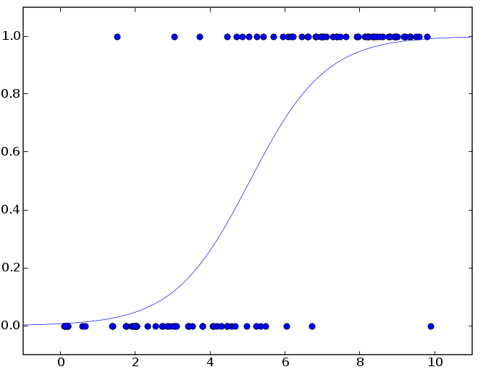
What is Logistic Regression
A statistical method for modeling one or more independent variables
The model is a classifier
Predicts a binary outcome (aka dichotomous)
LR is a generalized linear model (GLM)
Learns parameters using loss with an optimizer
Outputs class probabilities

Slide 4

What is Logistic Regression
LR is linear because of the z = w^{T}x + b
The linear function (z) is the argument of the logistic function
The logistic function squashes all outputs to within [0, 1]
The vertical axis represents the probability of class 1

Slide 5
When To Use Logistic Regression
Logistic regression is good for creating basic binary classifiers from mixed data types
(categorical should be encoded)
Is someone in a high income bracket
Does someone have a disease
Some Examples:
Will a plane be on-time
Will a recipe get good reviews

Slide 6
Basics of Neural Networks
Multilayer Perceptron
Autoencoder
Recurrent
Convolutional
sigmoid (logistic)
ReLU (rectified linear unit)
tanh
linear
softmax
Activation Functions
Types

Slide 7
Layers
Example of a neural network composed of 4 layers.
inputs (x)
a(wx+b)
activation
output
Input
Layer
Hidden Layers
Output
Layer

Slide 8
Architectures
(MLP)

Slide 9
Architectures
(Convolutional)

Slide 10
Architectures
(Recurrent)
Recurrent NNs have nodes that connect back on themselves to learn sequences

